Slide 1
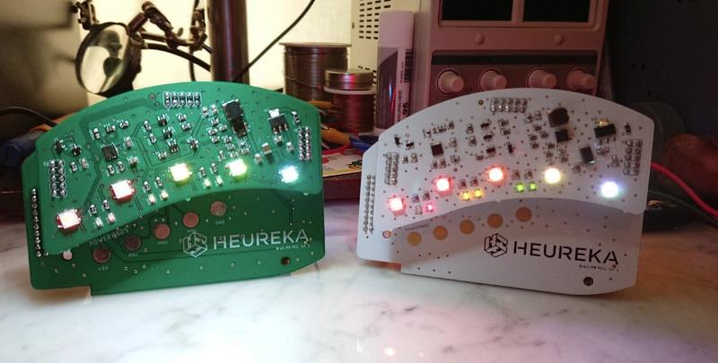
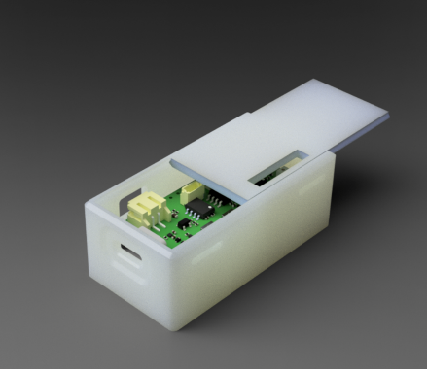
IT work culture in science centers
Be Innovative
Be Curious
Be Creative
Be Adaptive
Be a Driver
“You can’t plan the digital future, you need to build it”

Slide 2
What are the typical technical requirements for an exhibit? (IT perspective)
Reliable If two or three of our main exhibits (~200 exhibits on the floor) are down = ”NOTHING WORKS”. Remotely managed
Replaceable Easily replaceable parts that can be found on the market or
enough spare parts. Lifecycle thinking
Customizable
All languages, texts, images, videos, sounds, parameters etc. has to be customizable. They should not depend on source code. Software versioning. Possibility to reuse code – module thinking

Slide 3
IT & EXHIBITIONS
Independent exhibition network
Utilize infrastructure that already exists
Read & store user data from exhibits
Data analytics and flows
Remotely monitor and manage exhibits and hardware
Automate exhibit updates and version control

Slide 4
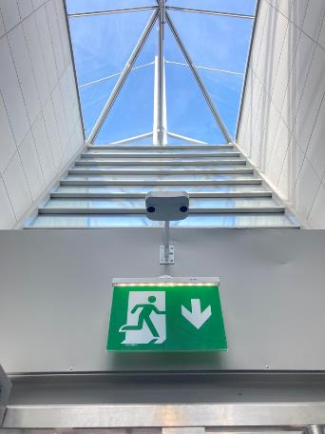
STATISTICS
Virtual servers – Database, MQTT & UI
Individual brokers for each exhibition
Different UI for selected use cases
Temperature & humidity measuring
Sensors for mechanical exhibits
Stores user and usage data from exhibits
Control tasks
”The backend planning started when we had to figure out a way to synchronize 18 videoplayers, 4 audioplayers and 30 speakers”

Slide 5
Something to think about
Simple data is collected from the exhibits
The data varies depending on the exhibit; the current examples are just for reference
For now, we proceed with a try and fail approach
There are errors in the data interpretation
It would be good to find ways and heuristics for extracting the correct data
What kind of data should we collect from the exhibits to get a better overall picture?

Slide 6
Something to think about
What metrics should be in place to improve the benefits?
Data is constantly increasing; what metrics should be developed? Consider things and metrics that would be useful for Heureka's operations
Where could we set target values and actually measure the progress and development of the target?
Consider what would be useful and how to measure and analyze it
Can data be turned into metrics for development that would be useful in future exhibition planning?

Slide 7
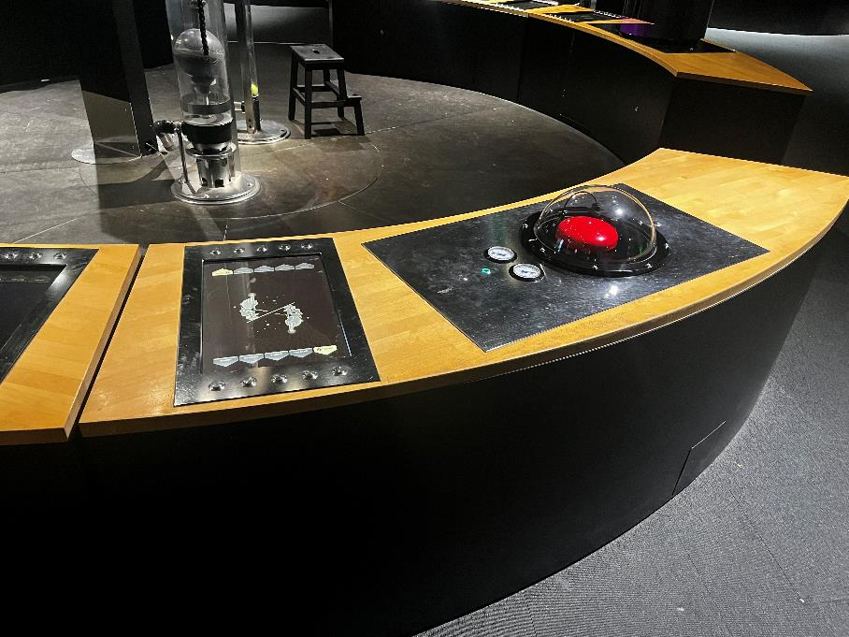
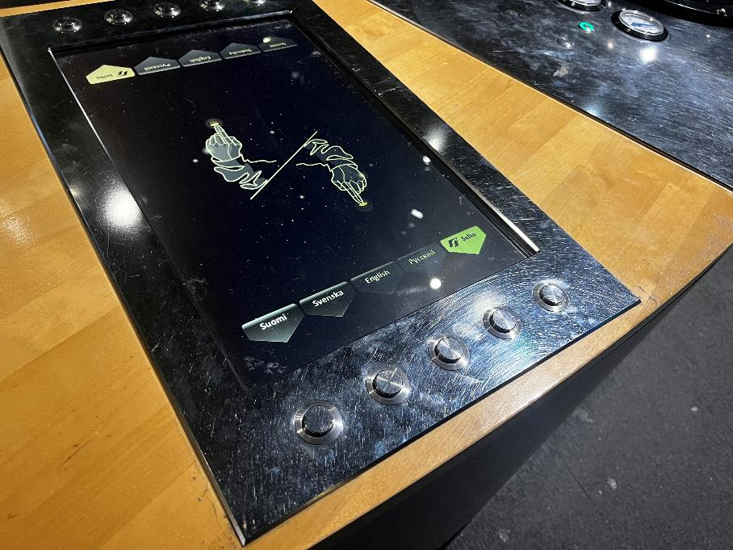
CLASSICS – For whom the bell tolls

Slide 8
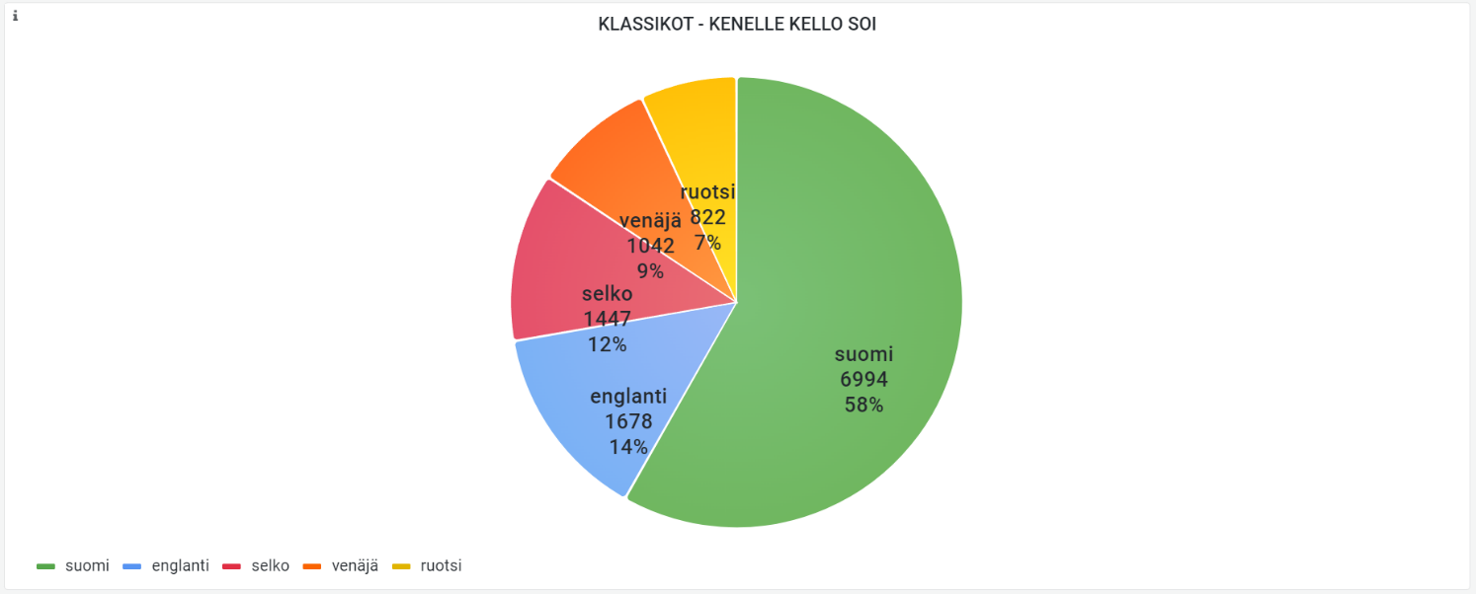
CLASSICS – For whom the bell tolls

Slide 9
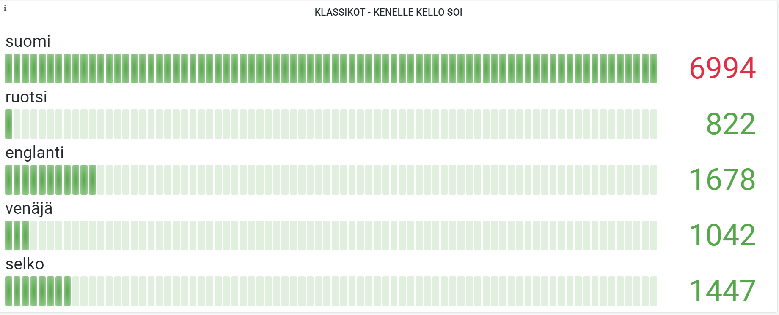
CLASSICS

Slide 10
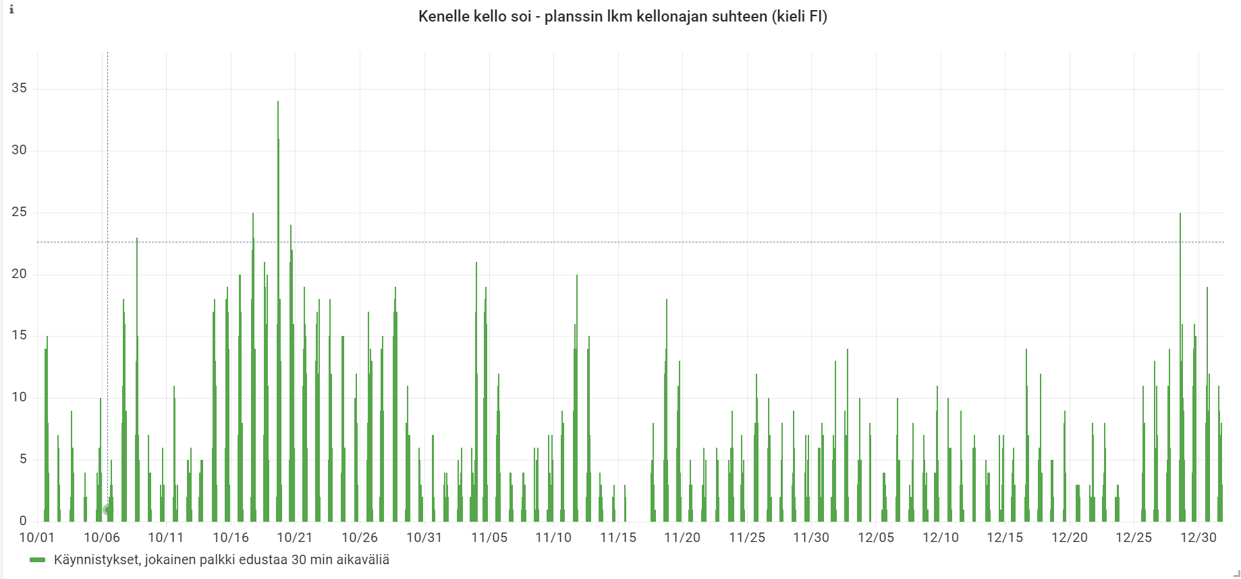
CLASSICS

Slide 11
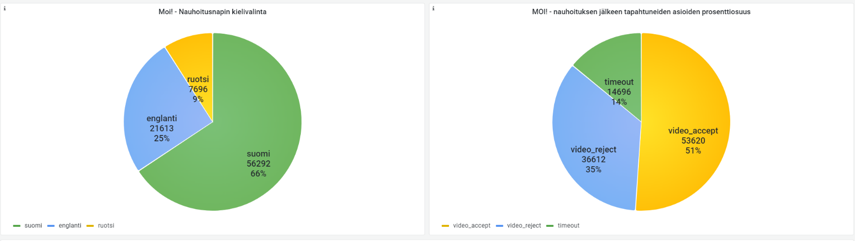
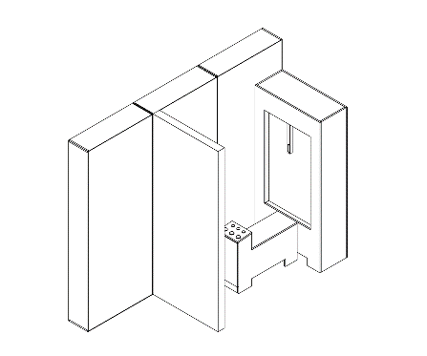
NATURAL DISASTERS - Hello

Slide 12
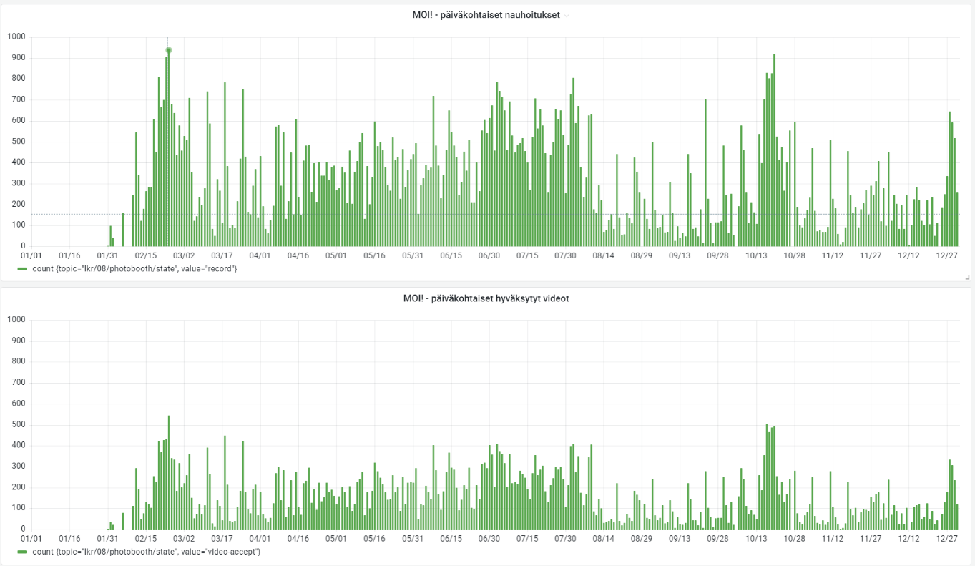
NATURAL DISASTERS - Hello

Slide 13
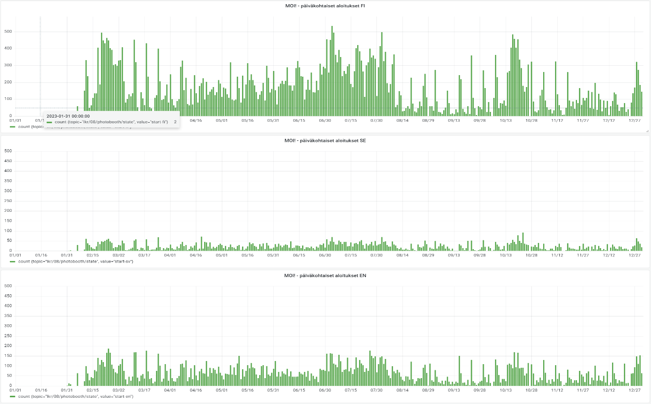
NATURAL DISASTERS - Hello

Slide 14
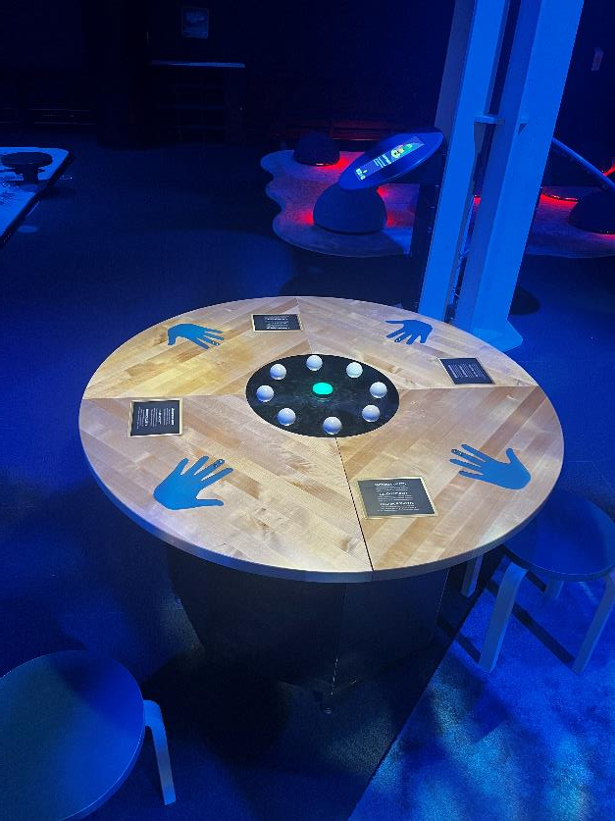
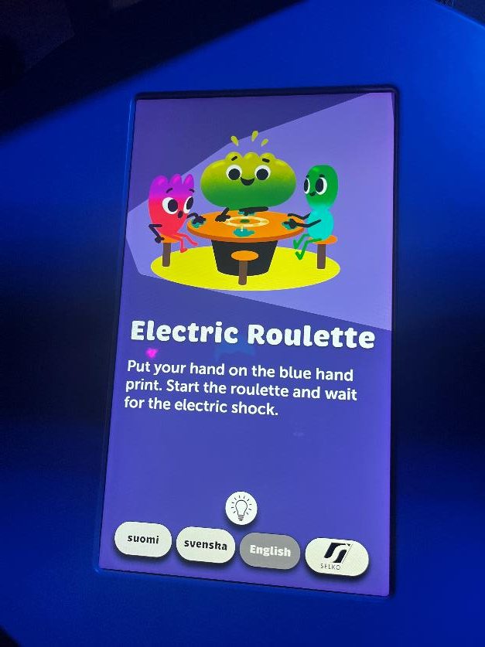
POWER OF PLAY – Electrical Roulette

Slide 15
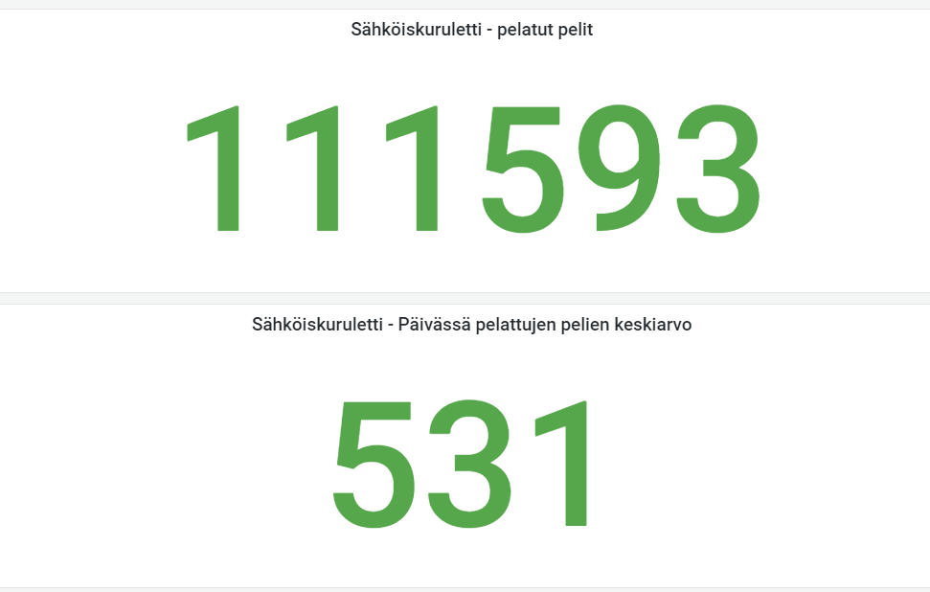
POWER OF PLAY – Electrical Roulette

Slide 16
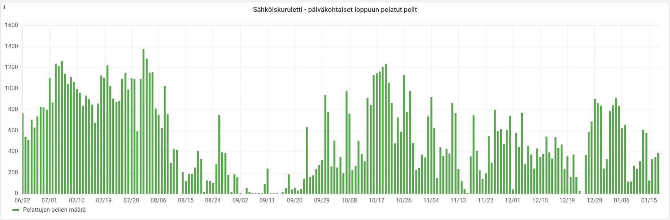
POWER OF PLAY – Electrical Roulette

Slide 17
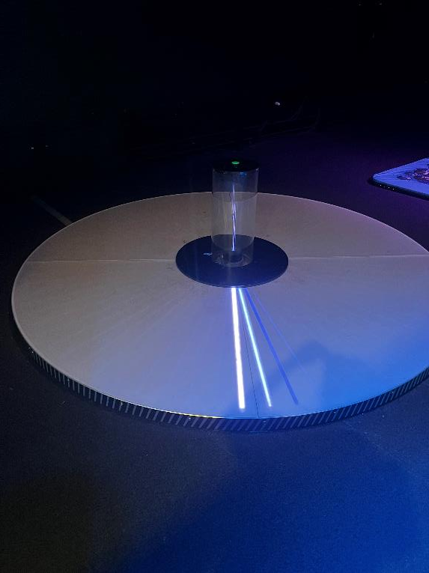
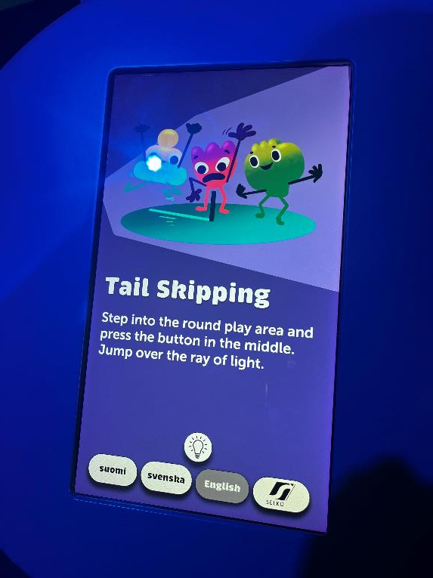
POWER OF PLAY – Tail skipping

Slide 18
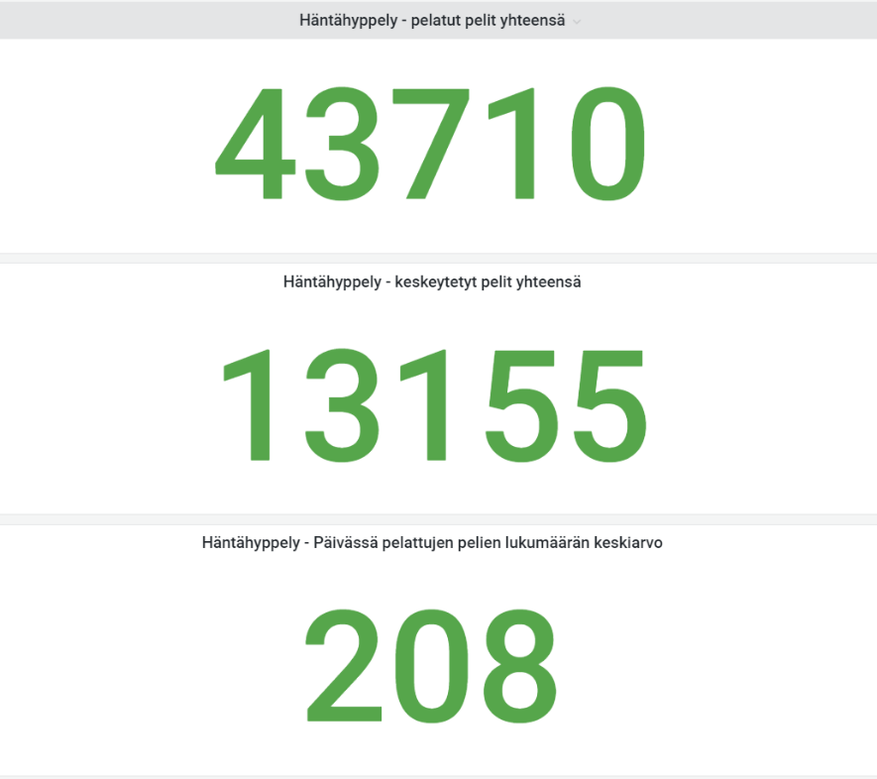
POWER OF PLAY – Tail skipping

Slide 19
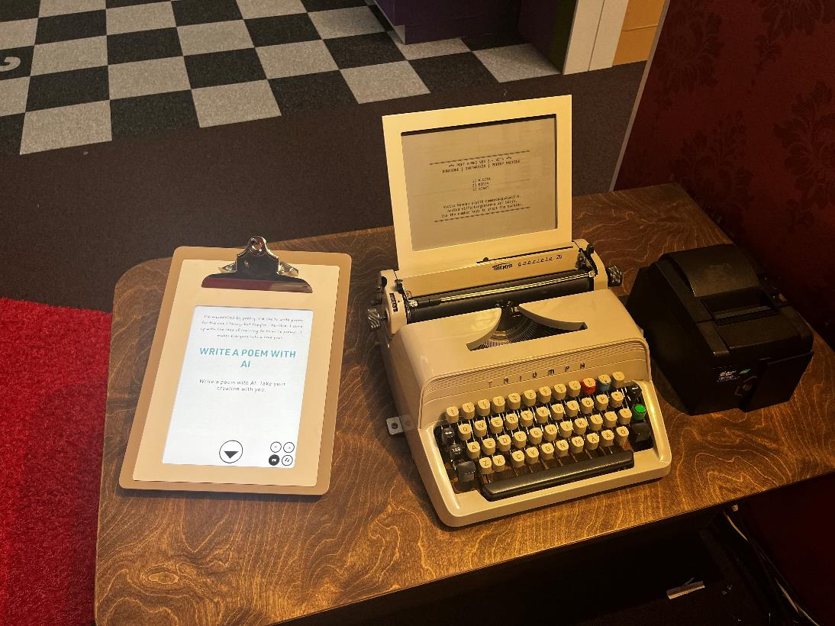
ME, MYSELF & AI – Poet machine

Slide 20
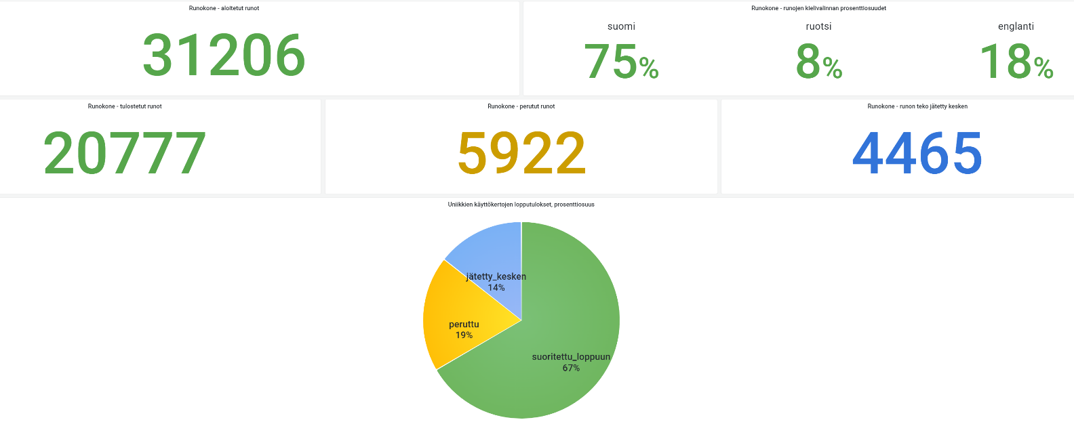
ME, MYSELF & AI – Poet machine

Slide 21
ME, MYSELF & AI – Case Poet machine
Max capacity at 1500 visitors
Notes:
Keskittymistä vaativa kohde
Paljon tasaisempi käyrä, maksimiin iskeydeytään jo 1500 paikkeilla

Slide 22
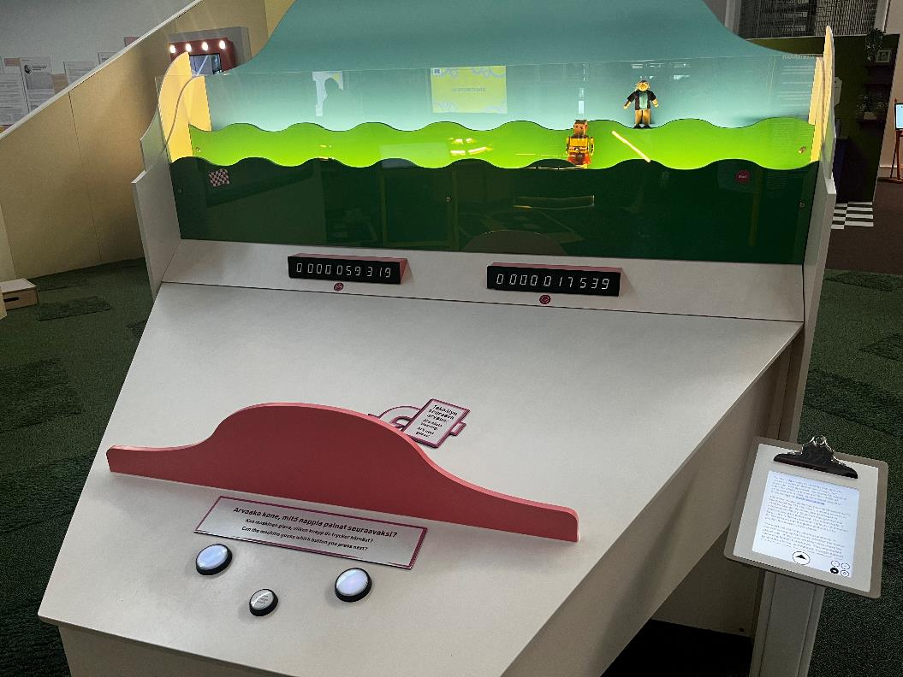
ME, MYSELF & AI – Mind Reader
Notes:
The mind reader game has been built based on “A Mind-Reading (?) Machine”, a memo written in 1953 by Claude Shannon, the developer of information theory. Shannon thought that our choices could be predicted. The mind reader’s basic idea is that a computer collects information on the progress of the game and uses it to predict the player’s next choice.

